Slide 1
Lecture 12.3 Firm specific assets and hold up

Slide 2
Firm specific assets and hold up
Firm-specific assets
a relationship or asset is specific to the firm if it is substantially more valuable within the firm than in the next best available use
e.g. Alaskan oil pipeline, a coal mine next to a power plant, software written for a specific firm
Where does specificity derive from?
Site specificity: an asset is useful to a limited set of users due to location. e.g. a coal mine or a steel mill
Physical specificity: an asset is suited to a firm due to design. e.g. a mould used to make a car body; software designed for a firm
Human asset specificity: a transaction requires specialised knowledge. e.g. knowledge needed to write and use software
Dedicated assets: an asset that is intrinsically tied to a firm. e.g. investments made by a port owner

Slide 3
Firm specific assets and hold up
Why does specificity create problems?
if one party needs to make a relationship-specific investment, they are vulnerable to the hold up problem
An example: A and B have a profit opportunity. Timing:
1. A decides whether to invest $6m in the project. 2. If A invested, A and B can earn combined profits of $10m.
Suppose A and B negotiate a contract before A invests
What might the contract look like?
Suppose A and B negotiate a contract after A invests
What might the contract look like?

Slide 4
Firm specific assets and hold up
Consider the following situation:
A firm makes an investment of $50,000 in a machine tool to make a specific component for XYZ Inc.
Assume that variable cost of production is $1 and the life of the machine is 50,000 units.
Requires payment of $2 per item to break even.
What might happen after contract signed and the investment has been made?
the buyer has an incentive to argue “circumstances have changed” and to bargain the price down to $1 per piece
this may be possible if the contract is incomplete
Hold-up problem
One way to think about the problem here is that after the investment has been made it is a sunk cost and one of the parties can exploit this. The implication?

Slide 5
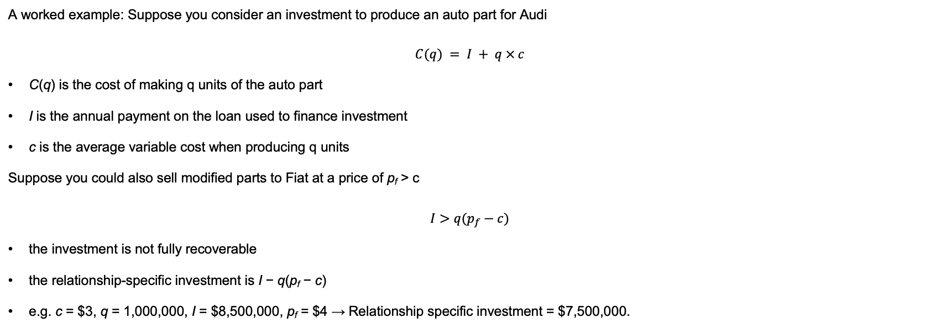
Firm specific assets and hold up
A worked example: Suppose you consider an investment to produce an auto part for Audi
$$C(q) = I + q × c$$
C(q) is the cost of making q units of the auto part
I is the annual payment on the loan used to finance investment
c is the average variable cost when producing q units
Suppose you could also sell modified parts to Fiat at a price of p_{f} > c
$$I>q(p_{f}−c)$$
the investment is not fully recoverable
the relationship-specific investment is I − q(p_{f} − c)
e.g. c = $3, q = 1,000,000, I = $8,500,000, p_{f} = $4 → Relationship specific investment = $7,500,000.

Slide 6
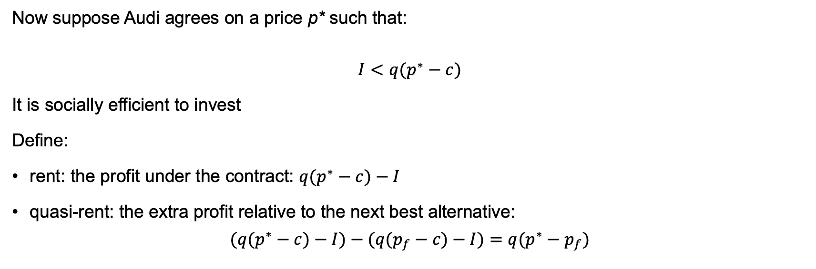
Firm specific assets and hold up
Now suppose Audi agrees on a price p* such that:
$$I<q(p^{∗}−c)$$
It is socially efficient to invest
Define:
rent: the profit under the contract: $q(p^{∗}−c)−I$
quasi-rent: the extra profit relative to the next best alternative:
$$(q(p^{∗}−c)−I)−(q(p_{f}−c)−I)=q(p^{∗}−p_{f})$$

Slide 7
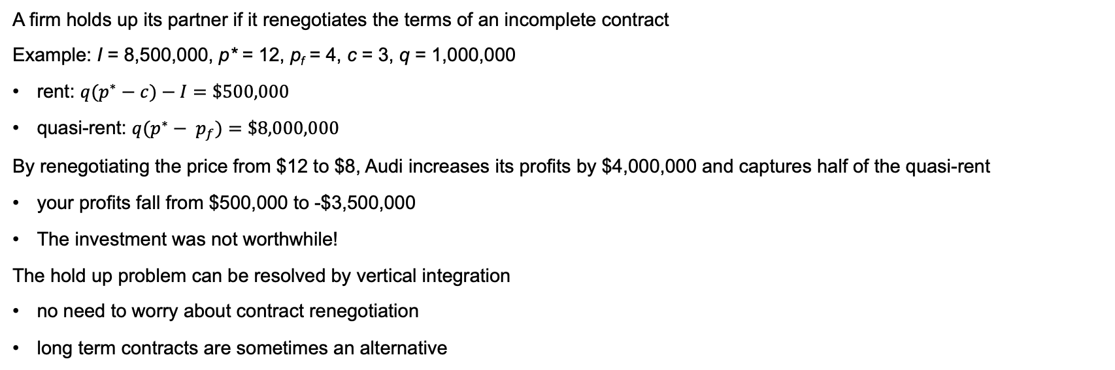
Firm specific assets and hold up
A firm holds up its partner if it renegotiates the terms of an incomplete contract
Example: I = 8,500,000, p* = 12, p_{f} = 4, c = 3, q = 1,000,000
rent: $q(p^{∗}−c)−I=\$500,000$
quasi-rent: $q(p^{∗}− p_{f})=\$8,000,000$
By renegotiating the price from $12 to $8, Audi increases its profits by $4,000,000 and captures half of the quasi-rent
your profits fall from $500,000 to -$3,500,000
The investment was not worthwhile!
The hold up problem can be resolved by vertical integration
no need to worry about contract renegotiation
long term contracts are sometimes an alternative

Slide 8
Firm specific assets and hold up
There are many cases of hold up in the ‘real world’.
Perhaps the most famous is the Fisher Body GM example in which Fisher Body made the chassis for GM cars
GM approached Fisher and asked Fisher to make the necessary investments – of course such a request left both parties hostage to a potential hold up problem.
While a contract was signed between Fisher and GM whereby Fisher was protected via clauses specifying price as a markup over variable cost, this created incentives for Fisher Body to pad variables costs.
Eventually GM purchased Fisher at a high cost.
(As an aside, more recent evidence suggests that the actual experience of the two firms is not as simple as suggested above. Rather the relationship between the firms was somewhat more complex and that it was not a simple case of hold-up as described.)

Slide 9
Firm specific assets and hold up
The GM-Fisher Body example highlights that hold up is a two-way street, the upstream ‘owner of an asset’ can take actions that are inefficient but nonetheless benefit itself.
As we will see in a numerical example later, ownership/ vertical integration doesn’t necessarily solve the problem of hold up.
Gibbons suggests that relational contracts between firms, not just those within firms, might also be important to address some of the issues associated with incomplete (formal) contracts.
Ultimately, vertical integration is one way that the hold up problem can be resolved, but it may create different types of problems.
The hold up problem may be alleviated with vertical integration – that is the use of non-market transactions.
Obviates the need to worry about ‘new circumstances’ and contract renegotiation
An alternative would be long term contracts, but these come with costs and benefits discussed in more detail in the next section.

